Slide 1
ALL ABOUT PURE STRIDE PROFESSIONAL FOOT PADS

Slide 2
Gel Heel Spur Cushions
Gel heel cushions that absorb shock at heel strike.
Able to fit under or over custom orthotics.

Slide 3
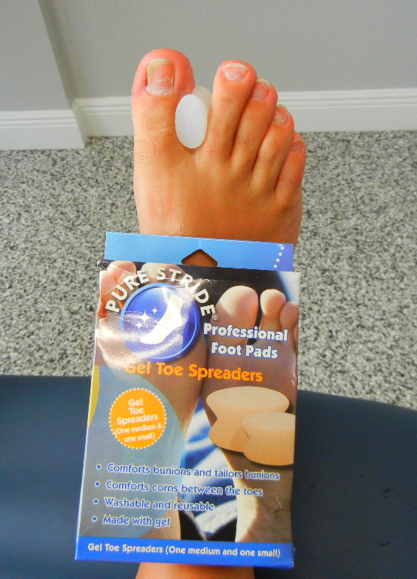
Gel Toe Spreaders
Silicon gel spacer to separate great toe from second toe to prevent progression of bunions
Washable and reusable

Slide 4
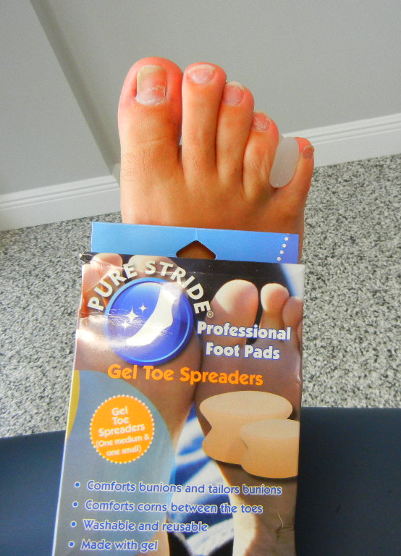
Gel Toe Spreaders
One medium and small gel spreader to decrease pressure on interdigital soft corns
Washable and reusable

Slide 5
Gel Toe Cap
Silicon gel toe cap provides cushion for ingrown nails and corns
Washable and reusable

Slide 6
Gel Toe Cap
Silicon gel cap to cushion ingrown nails and calluses on the great toe
Washable and reusable

Slide 7
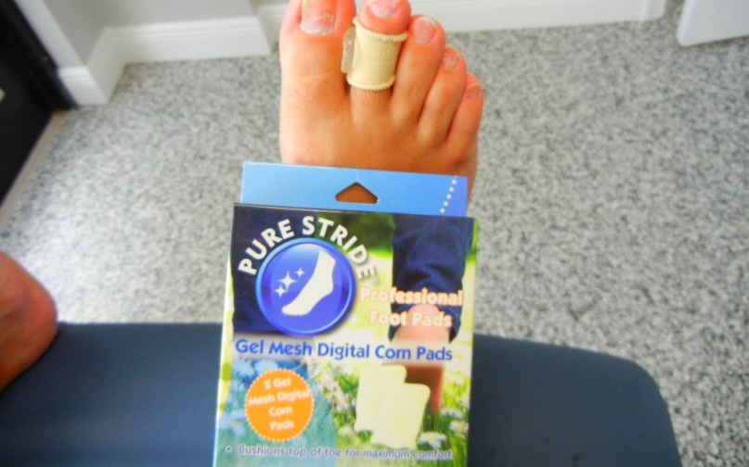
Gel Mesh Digital Corn Pad
Cushions corns on the top and sides of the toes
Washable and reusable

Slide 8
Gel Toe Separators
Silicon gel separators to cushion corns in between the toes
Washable and reusable

Slide 9
Gel Hammer Toe Crest Pad
Silicon gel toe crest pad to off-load the tips of the toes when hammer toes or claw toes are present.
Prevents ulceration of the tips of the toes
Washable and reusable

Slide 10
Gel Cushion for Ball of Foot
Cushions the ball of the foot
Adds more cushioning when normal fat pad on the ball of the foot has decreased
Washable and reusable

Slide 11
Gel Metatarsal Cushion
Self adhesive metatarsal cushion for pain on the balls of the feet
Washable and reusable

Slide 12
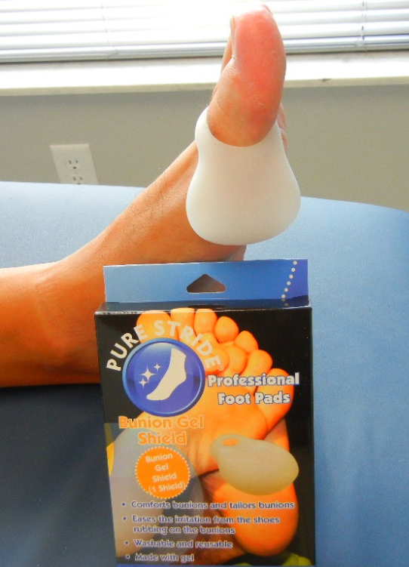
Bunion Gel Shield
Cushions inflamed bunions
Shields the great toe joint from shoe pressure
Washable and reusable

Slide 13
Gel Callus Cushions
Self adhesive gel cushion to off-load a painful callus on the ball of the foot
Washable and reusable

Slide 14
Gel Toe Separators
Gel separators for interdigital soft corns
Washable and reusable

Slide 15
Gel Mesh Toe Tubes
Gel toe tubes that cushion overlying corns from shoe pressure
Washable and can be trimmed

